Slide 1
CS 441 - Software Engineering
Yongjie Zheng
Office: Science Hall 2 341
Email: yzheng@csusm.edu
Phone: (760) 750-8023

Slide 2
What happened 50 years ago - Margaret Hamilton
No field for software engineering...you were on your own...knowledge (or lack thereof) passed down from person to person.
Tricky programmers admired; organization vulnerable when one left.
Terms undefined: leading to errors, misunderstandings and drama; e.g., "software", "error" and "computer systems" meant different things to different people.
If a system crashed, software the one blamed (THERAC-25).
Life cycle not unlike today's traditional life cycle. Waterfall, Spiral, Agile... going from requirements to coding to endless testing and maintenance.
No tools for finding errors.
Source: https://www.icse2018.org/getImage/orig/SE50th.10w.0.pdf

Slide 3
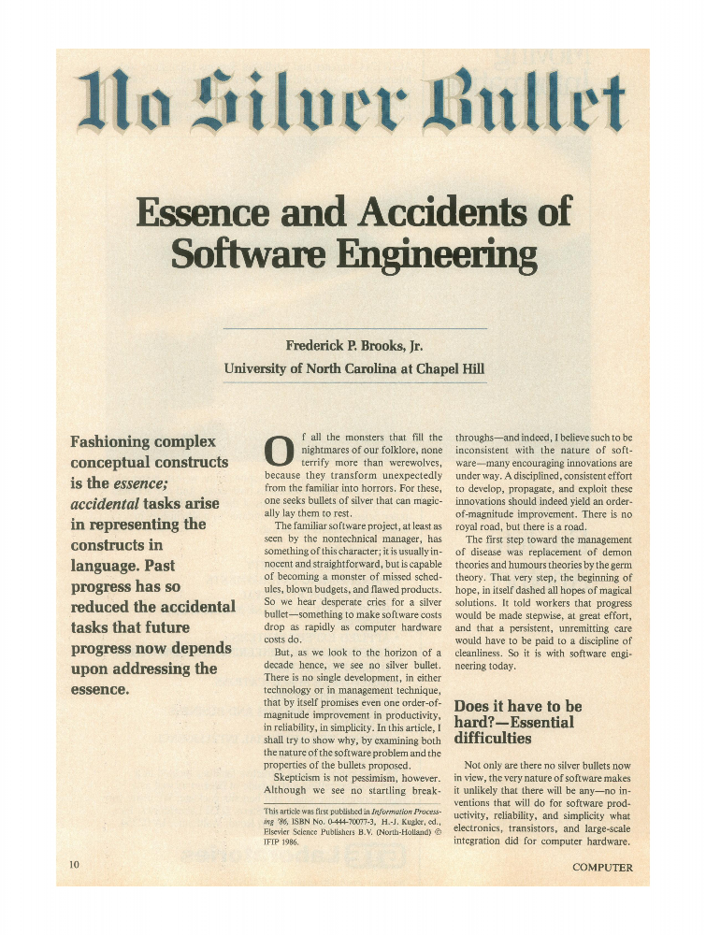
Software is essentially hard to build – Fred Brooks
Complexity: software systems differ profoundly from computers, buildings, or automobiles, where repeated elements abound.
E.g., Windows NT - 1.8 million SLOC; Windows XP - 45 million SLOC.
Conformity: software is designed by different people and must conform to different interfaces.
There is no unifying rules to follow.
Changeability: The software entity is constantly subject to pressures for change.
Changes may be made throughout the software development lifecycle, even after deployment.
Invisibility: software is invisible and unvisualizable.

Slide 4
What is software engineering?
Software: Computer programs and associated documentation (e.g., requirements specification, architectural models).
Software engineering: The systematic application of practical theories, methods, and tools to the production (e.g., design, implementation, and testing) of large software systems.
Programming-in-the-large (thus, requires collaborations between people).
Software products are to be used by people different from the original authors.
Requirements analysis, design, and testing.
Software engineering aims to improve productivity, quality, and predictability of software production.
Software engineering is a developing discipline.
E.g., Software Engineering vs. Automotive Engineering

Slide 5
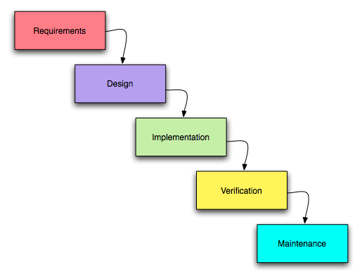
Software Development Process
Software process is a set of activities leading to the production of a software product.
What product we should work on next.
What criteria that work product must satisfy.
There is no standard or ideal process!
For some systems, such as critical systems, a very structured development process is required.
For business systems, with rapidly changing requirements, a flexible process is likely to be more effective.
For large systems, a mixed process is often preferred.

Slide 6
Software Development Process Models
Structured processes (plan-based, document-driven, rigor): build a software system in a one-round strict process.
Waterfall model: each development phase must derive a complete artifact for the next phase to start with.
V-Model: a variation of waterfall model.
Iterative processes (flexible): grow a software system in multiple iterations.
Incremental development: the specification is developed in conjunction with the source code.
Spiral model: identification, evaluation, and resolution of development risks.
Agile process: focus on source code, instead of documents; embrace changes; frequent releases; customer involvement; incremental delivery.
Other process models: Prototyping, Rational Unified Process, etc.

Slide 7
Requirements Analysis and Specification
Identify and document functional requirements and non-functional requirements (e.g., performance, reliability) of a software system.
The hardest single part of building a software system is deciding precisely what to build.- Fred Brooks.
Requirements elicitation
Prototyping, interviews, questionnaire, etc.
Requirements specification
User requirements: nature languages.
System requirements: use case models (e.g., use cases, use case diagrams), formal specification.
Requirements traceability

Slide 8
Software Architecture and Design
Make principal design decisions about the structure, behavior, and/or quality attributes of the system under development:
Decompose the system into components.
Select protocols for communication, synchronization, and data access.
Design components’ internal structure.
A good architectural design is the key to a successful software product.
Design software architecture
Principles: conceptual integrity, Information hiding, modularity, abstraction.
Techniques: Architecture patterns and styles (e.g., pipe-and-filter, MVC), function-oriented design, design patterns, object-oriented design and analysis, architecture recovery (extraction and clustering).
Model software architecture
Architecture description languages, UML, metamodels, domain-specific languages.

Slide 9
Software Testing
Execute the software using representative data samples and compare the actual results with the expected results.
White-box testing – structural, program-based testing
Test cases are designed, selected, and run based on the structure of source code (control-flow coverage, data-flow coverage).
Tests the nitty-gritty.
Drawbacks: need access to source code.
Black-box testing – functional, specification-based testing
Test cases are designed, selected, and run based on specifications.
Tests the overall system behavior.
Drawbacks: less systematic.
Unit Testing, Integration Testing, System Testing, and Regression Testing.

Slide 10
Other Software Engineering Topics
Software Implementation: software frameworks, (e.g., Spring, Apache Struts, Hibernate), integrated development environment (e.g., Emacs, Eclipse Plug-ins), code generation.
Software Maintenance: version control, reengineering(e.g., refactoring), change impact analysis, consistency management.
Software Metrics: coupling, cohesion, number of lines of code, constructive cost model (COCOMO).
Software Mining: reverse engineering, program analysis, code search, program comprehension and visualization.
Software Reuse and Software Product Lines
User Interface Design
Self-Adaptive Software Systems

Slide 11
Software Engineering vs. Computer Science
Computer science: data structure, programming languages, algorithm design and analysis (computation theory), operating system, computer architecture.
Computer science includes fundamental concepts, theories, and principles (e.g., data structure, algorithm) about computer programs.
Computer science is essential to software engineering.
Software engineering focuses on production of large software systems. It combines computer science with the engineering discipline.
Software engineering covers all the software development activities: requirements analysis and specification, software design, implementation (e.g., programming), testing, maintenance, etc.
Software engineering emphasizes documentation and tool support, in addition to computer programs.
Software engineering involves human beings (e.g., project managers, software developers, software users, and customers) and related facets (e.g., management, psychology, social science).

Slide 12
Reading Assignment
Frederick P. Brooks, Jr.. 1987. No Silver Bullet Essence and Accidents of Software Engineering. Computer 20, 4 (April 1987), 10-19.

